Slide 1
Update Matlab at to at least MATLAB R2018a,b including the toolbox
Install Jupyter using anaconda with Python 3.7 version
http://jupyter.org/install, https://www.anaconda.com/download/
Installing Jupyter Notebook using Anaconda
We strongly recommend installing Python and Jupyter using the Anaconda Distribution, which includes Python, the Jupyter Notebook, and other commonly used packages for scientific computing and data science.
First, download Anaconda. We recommend downloading Anaconda’s latest Python 3 version.
Second, install the version of Anaconda which you downloaded, following the instructions on the download page.
Congratulations, you have installed Jupyter Notebook! To run the notebook, run the following command at the Terminal (Mac/Linux) or Command Prompt (Windows):
DB Browser for SQLite https://sqlitebrowser.org/dl/

Slide 2
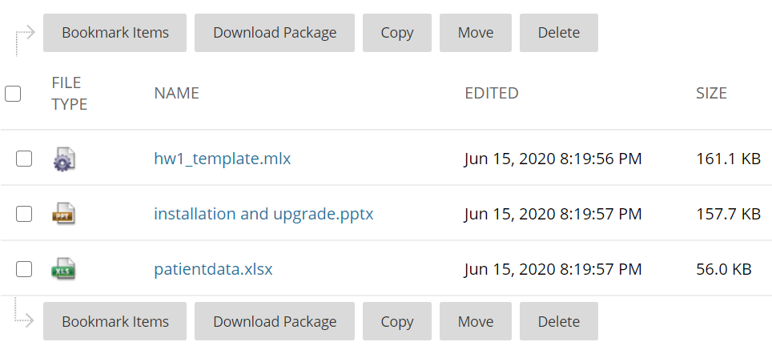
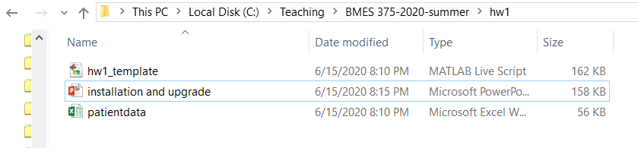
All files should be downloaded from blackboard to a single local folder
Blackboard
MATLAB_local folder

